Slide 1
3D Reconstruction Using Nerfstudio Software
Nicolás Araya
Universidad de O’Higgins

Slide 2






Me
Master Student in Electrical Engineering at Universidad de O’Higgins and RISLab Research Assistant.
Actual Research Fields:
Precision Agriculture IoT
Computer Vision
Deep Learning
Robotics
Nicolás Marcelo Araya Ponce

Slide 3
Index
Nerfstudio
Introduction to Neural Radiance Fields
Dataset Creation
Colab Hands On

Slide 4
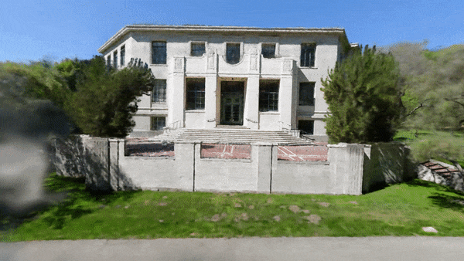
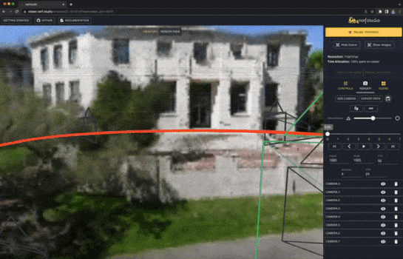
Nerfstudio
Nerfstudio provides a “simple” API that allows for a simplified end-to-end process of creating, training, and testing NeRFs.

Slide 5
Features
Modularized NeRF component frameworks.
Data Management.
Training Initialization.
Radiance Fields Rendering Visualization with Viser.
Yi, Brent, and contributors. Viser: Web-based 3D Visualization + Python. 2023. Accessed 21 May 2025. https://viser.studio/

Slide 6
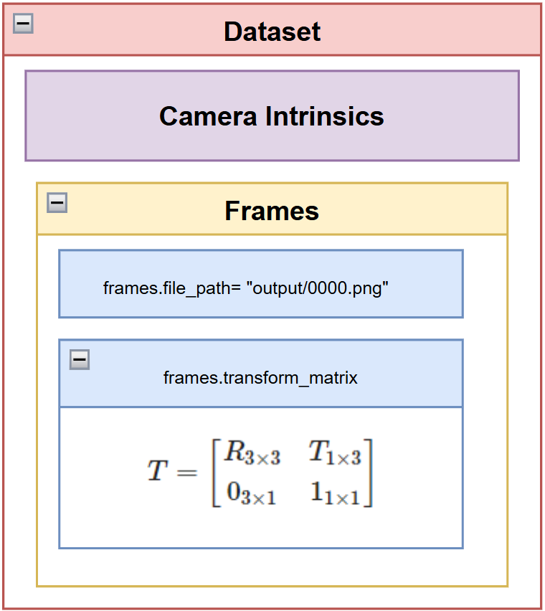
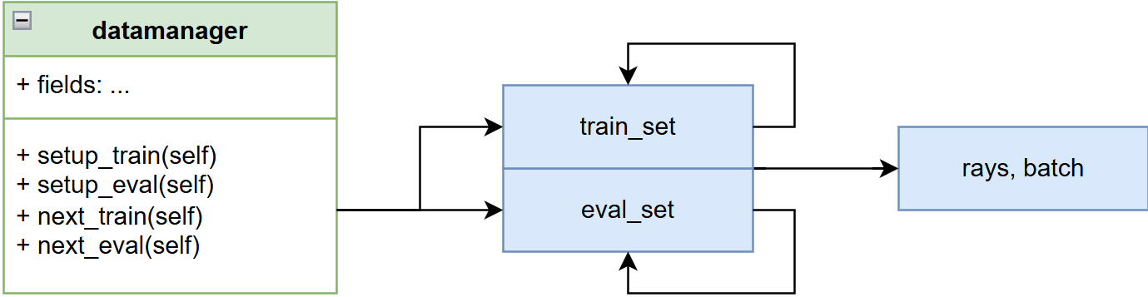
Core Components
DataManagers and DataParsers
Tancik, Matthew, et al. "Nerfstudio: A modular framework for neural radiance field development." ACM SIGGRAPH 2023 conference proceedings. 2023.

Slide 7
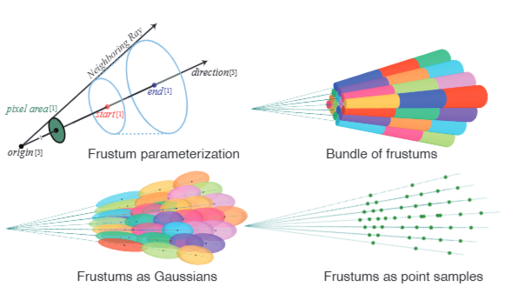
Core Components
RayBundles, RaySamples, and Frustums
Tancik, Matthew, et al. "Nerfstudio: A modular framework for neural radiance field development." ACM SIGGRAPH 2023 conference proceedings. 2023, Figure 4

Slide 8
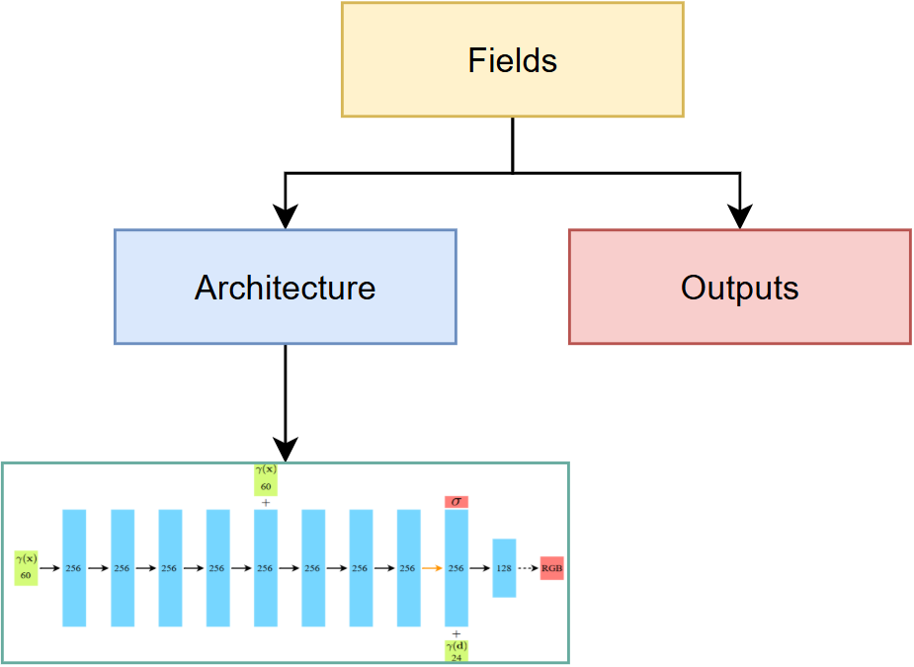
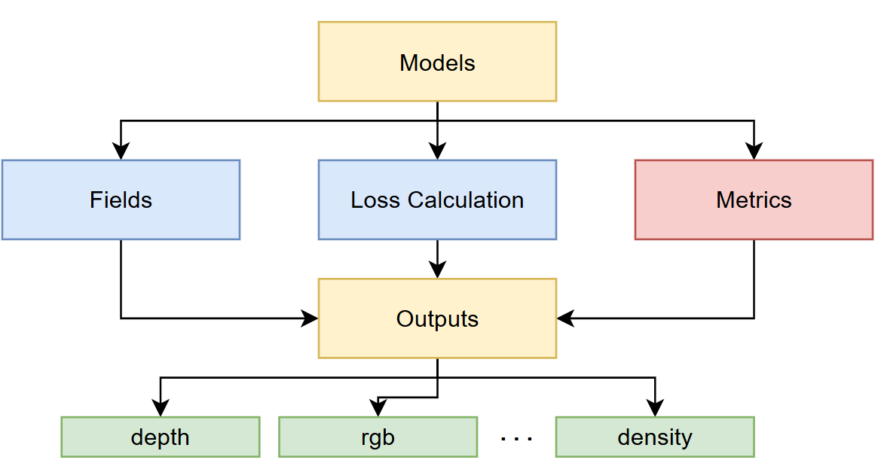
Core Components
Models and Fields for each Framework
Tancik, Matthew, et al. "Nerfstudio: A modular framework for neural radiance field development." ACM SIGGRAPH 2023 conference proceedings. 2023.

Slide 9
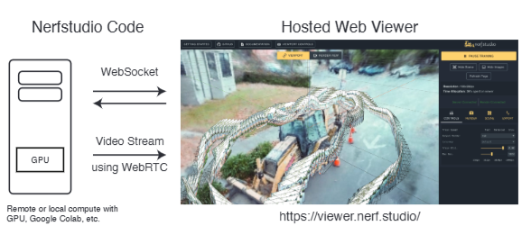
Core Components
Real Time Web Viewer
Tancik, Matthew, et al. "Nerfstudio: A modular framework for neural radiance field development." ACM SIGGRAPH 2023 conference proceedings. 2023, Figure 5

Slide 10
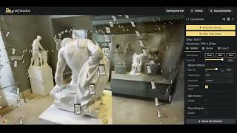
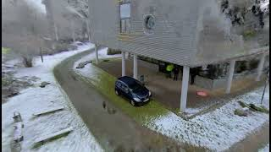
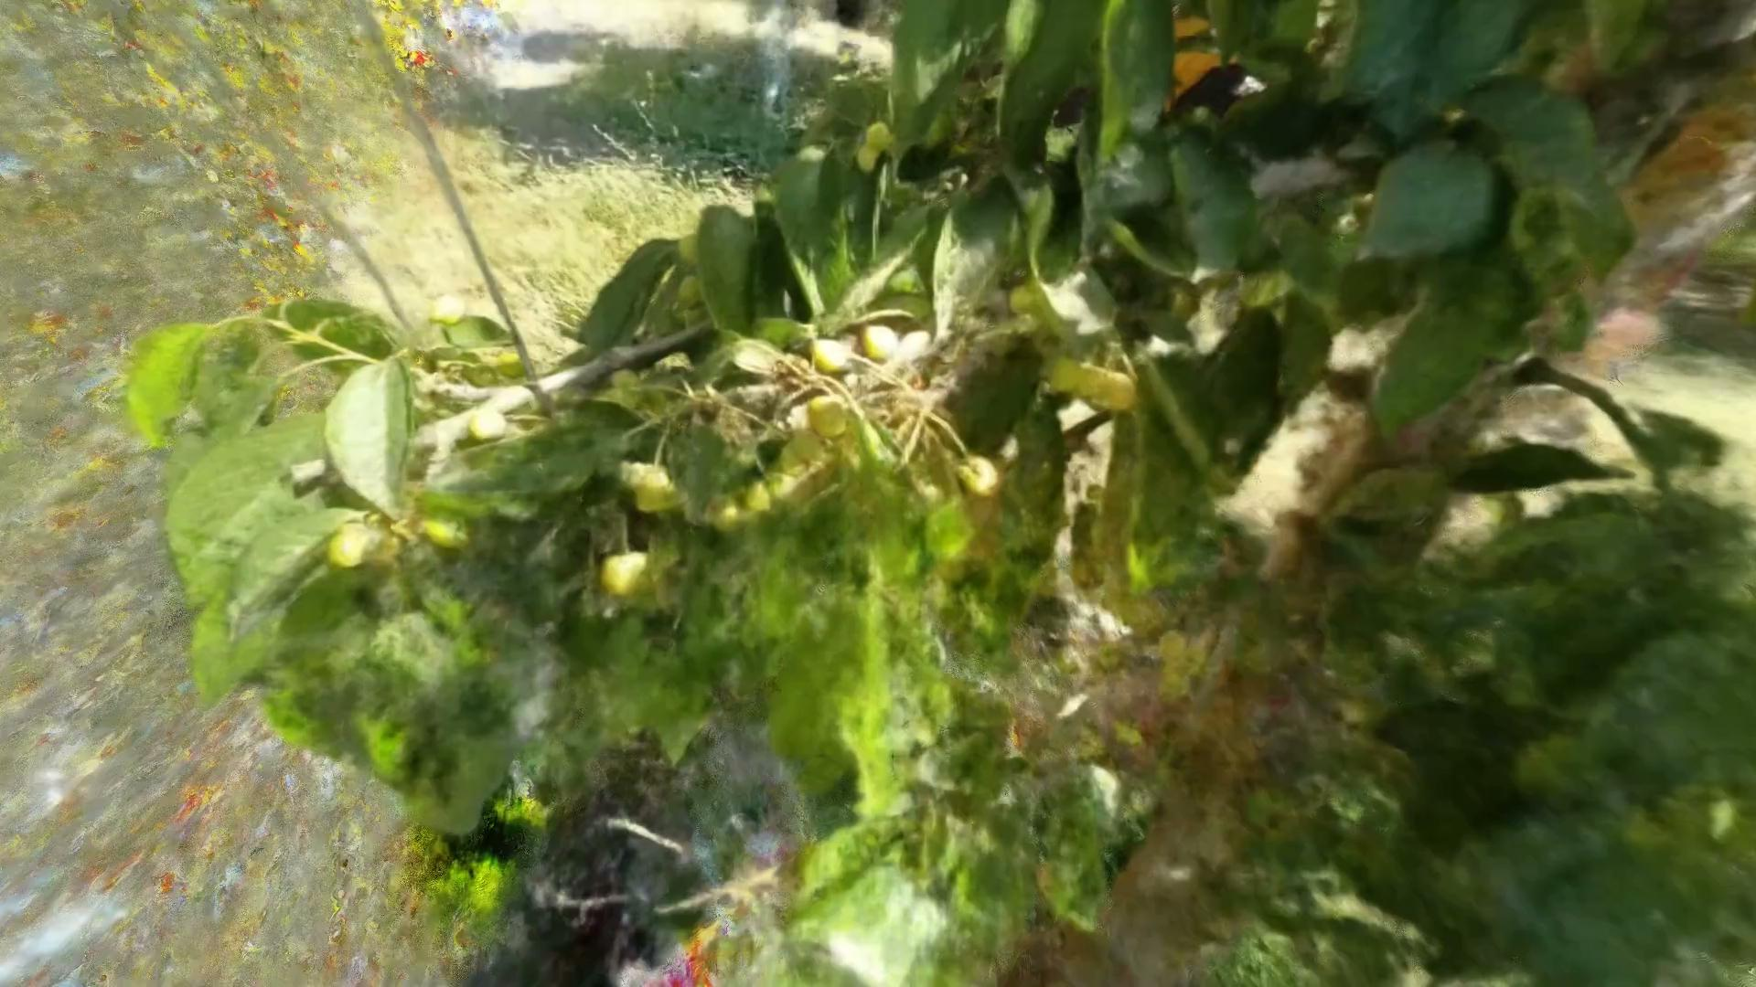
Introduction to Neural Radiance Fields

Slide 11
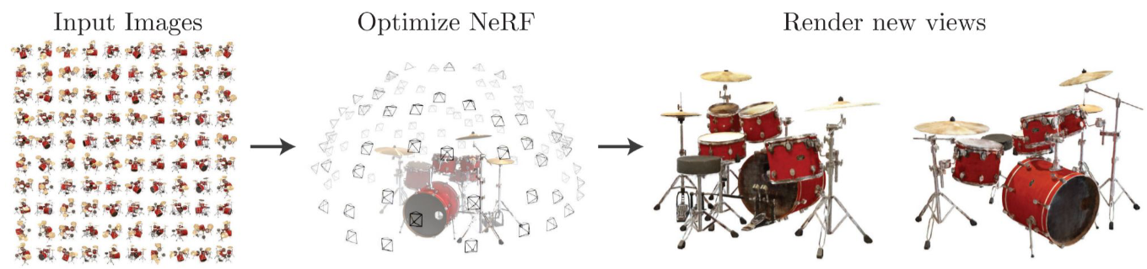
NeRF objective
Given a set of input images, optimize a continuous volumetric representation of a scene.
Mildenhall, Ben, et al. "Nerf: Representing scenes as neural radiance fields for view synthesis." Communications of the ACM 65.1 (2021): 99-106.

Slide 12
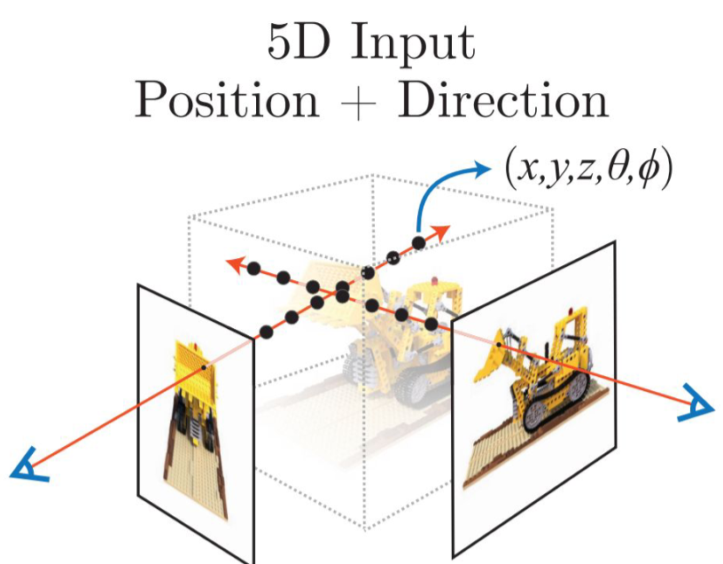
NeRF Input
Mildenhall, Ben, et al. "Nerf: Representing scenes as neural radiance fields for view synthesis." Communications of the ACM 65.1 (2021): 99-106.

Slide 13
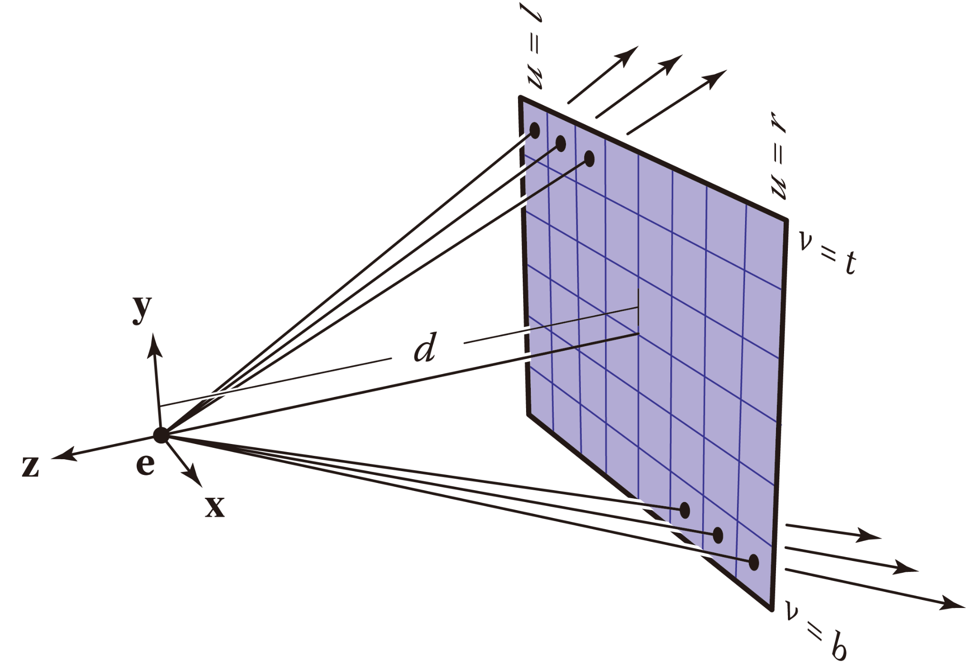
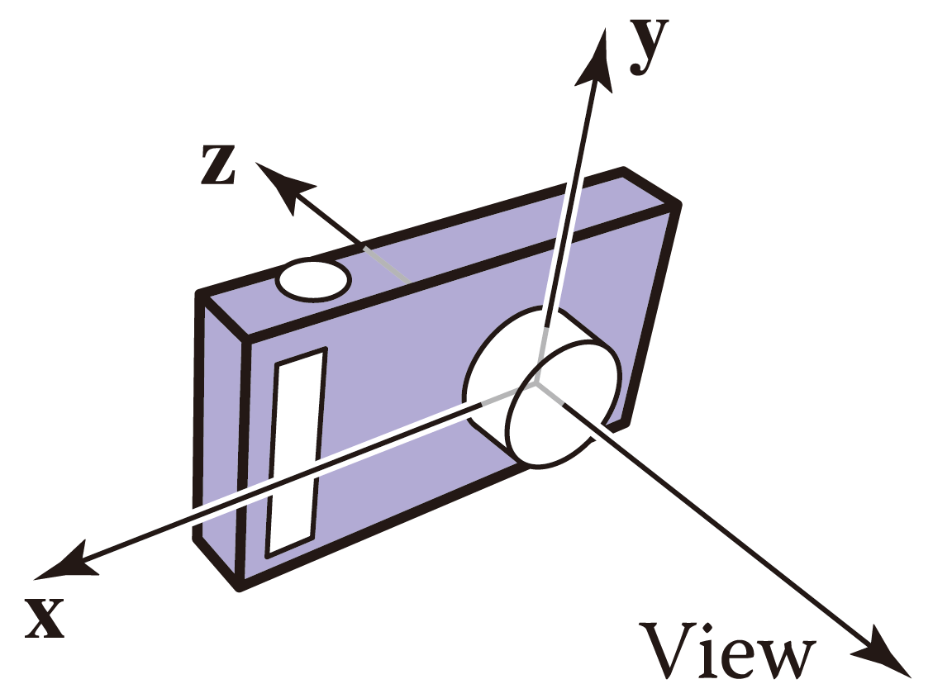
Ray Generation
Yu, Yue. "NeRF: How NDC Works." Yue Yu's Blog, 12 Aug. 2022, yconquesty.github.io/blog/ml/nerf/nerf_ndc.html#background. Accessed 21 May 2025.

Slide 14
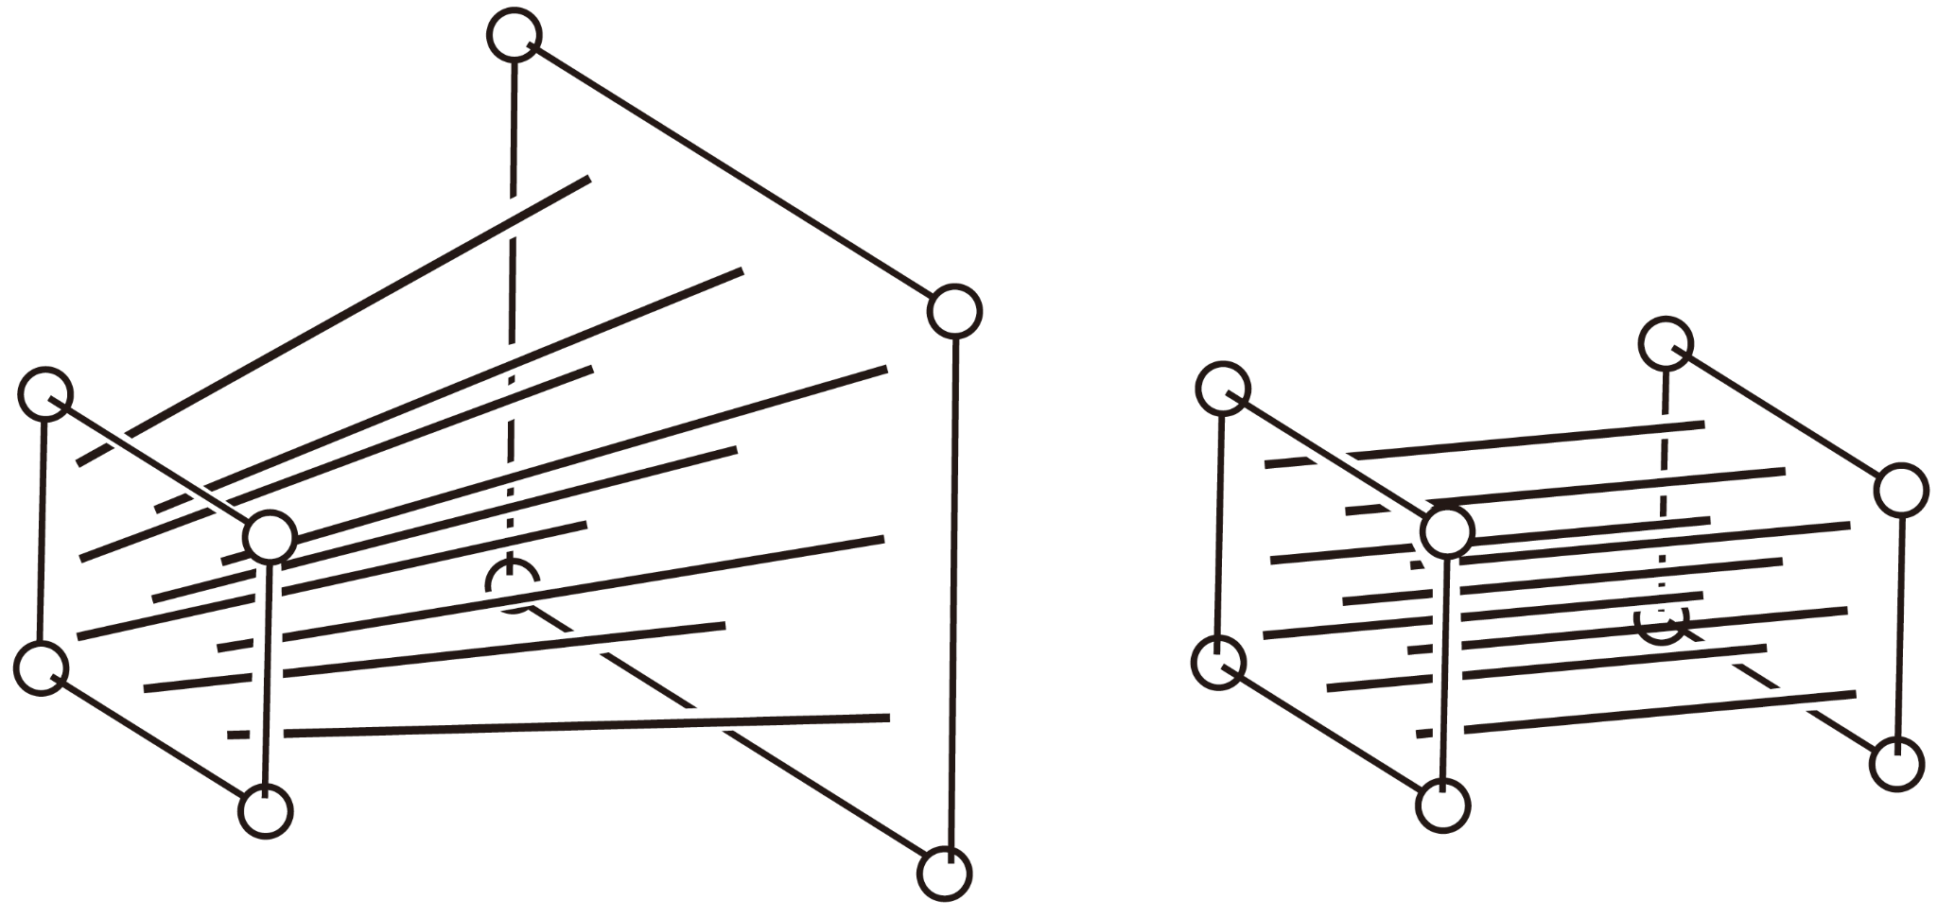
Ray Generation
Yu, Yue. "NeRF: How NDC Works." Yue Yu's Blog, 12 Aug. 2022, yconquesty.github.io/blog/ml/nerf/nerf_ndc.html#background. Accessed 21 May 2025.

Slide 15
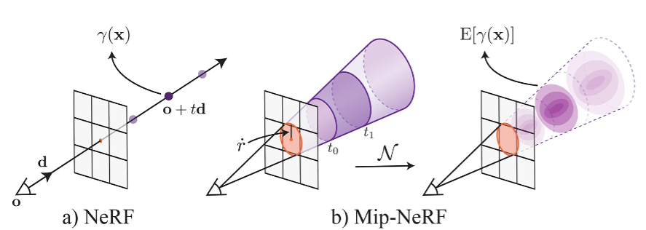
Ray Generation
Gao, Kyle, et al. "Nerf: Neural radiance field in 3d vision, a comprehensive review." arXiv preprint arXiv:2210.00379 (2022).

Slide 16
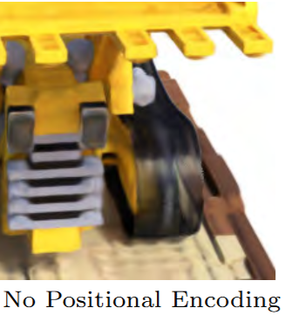
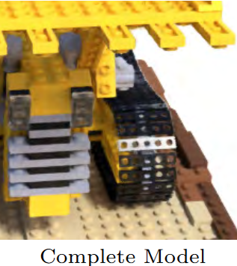
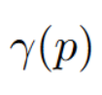
Vanilla NeRF Positional Encoding
Mapping the inputs to a higher dimensional space using high frequency functions before passing them to the network enables better fitting of data that contains high frequency variation.
1 Mildenhall, Ben, et al. "Nerf: Representing scenes as neural radiance fields for view synthesis." Communications of the ACM 65.1 (2021): 99-106. 2 Rahaman, Nasim, et al. "On the spectral bias of neural networks." International conference on machine learning. PMLR, 2019.

Slide 17
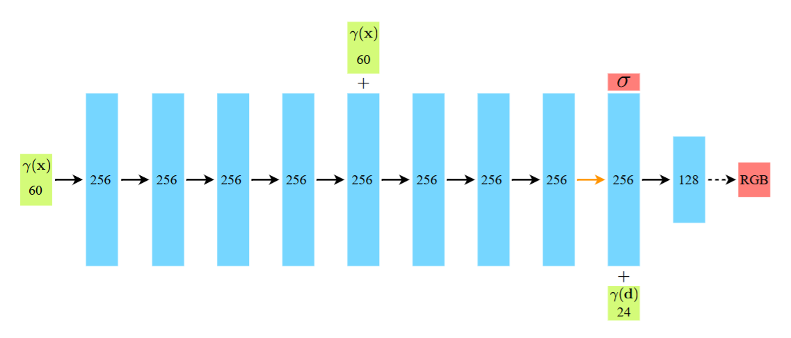
General NeRF Architecture
MLP Base with 8 fully connected layers with 256 channels per layer.
MLP Head with 256 channels takes this feature, concatenates it with the encoded view direction, and maps it to the final output.
Inputs: MLP Base: PE(x,y,z) | MLP Head PE(directions) + Density Embeddings
Outputs: Density & Radiance (RGB)
Mildenhall, Ben, et al. "Nerf: Representing scenes as neural radiance fields for view synthesis." Communications of the ACM 65.1 (2021): 99-106.

Slide 18
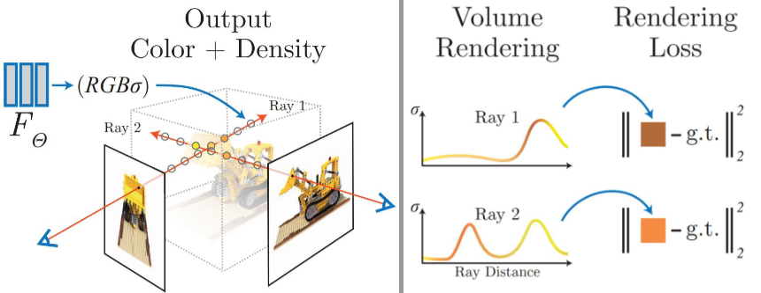
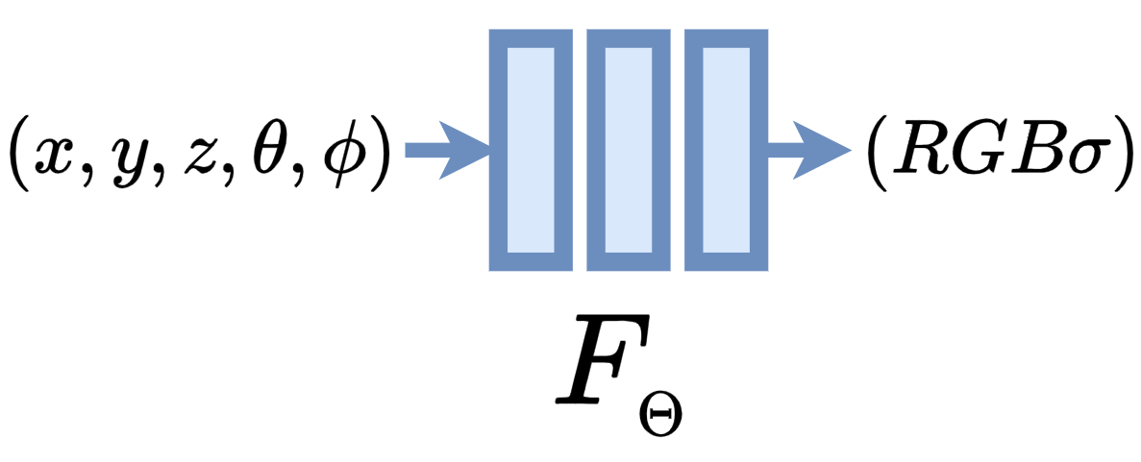
NeRF Output

Slide 19
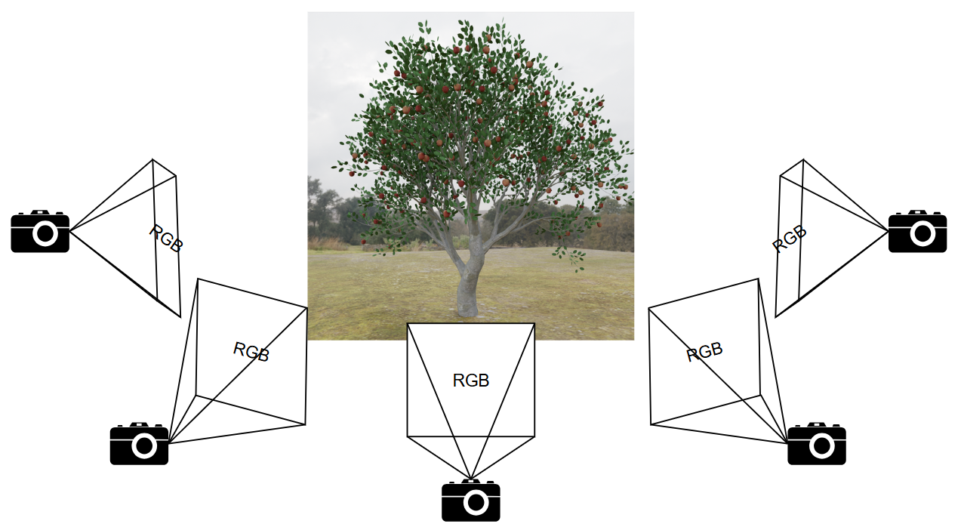
Steps to Create a Dataset
Scene Capturing

Slide 20
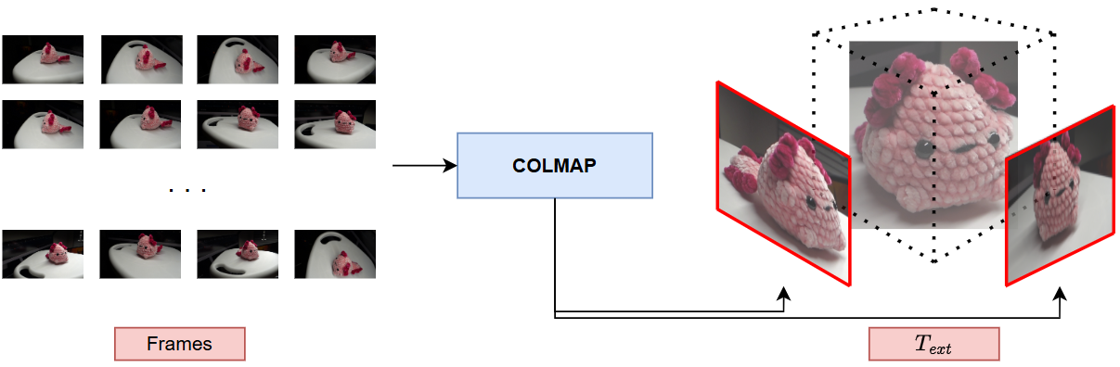
Steps to Create a Dataset
Obtaining the Camera Parameters for each frame
Structure From Motion
Known Camera Parameters

Slide 21
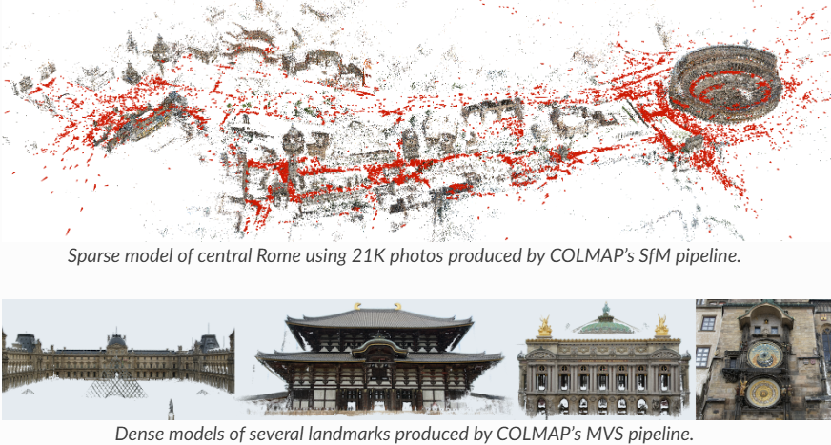
COLMAP
COLMAP is a general-purpose Structure-from-Motion (SfM) and Multi-View Stereo (MVS) pipeline.
1 Schönberger, Johannes L., et al. "Pixelwise view selection for unstructured multi-view stereo." Springer International Publishing, 2016.
2 Schonberger, Johannes L., and Jan-Michael Frahm. "Structure-from-motion revisited." Proceedings of the IEEE conference on computer vision and pattern recognition. 2016.

Slide 22
Steps to Create a Dataset
transforms.json “data compilation”

Slide 23

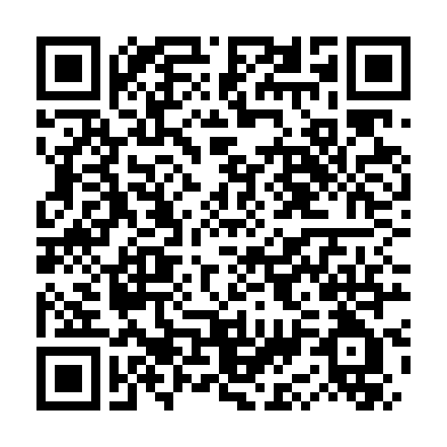
Nerfstudio Hands On!
http://bit.ly/Nerf-Hands-On

Slide 24
References
Tancik, Matthew, et al. "Nerfstudio: A modular framework for neural radiance field development." ACM SIGGRAPH 2023 conference proceedings. 2023.
Mildenhall, Ben, et al. "Nerf: Representing scenes as neural radiance fields for view synthesis." Communications of the ACM 65.1 (2021): 99-106.
Lombardi, Stephen, et al. "Neural volumes: Learning dynamic renderable volumes from images." arXiv preprint arXiv:1906.07751 (2019).
Rahaman, Nasim, et al. "On the spectral bias of neural networks." International conference on machine learning. PMLR, 2019.
Yu, Yue. "NeRF: How NDC Works." Yue Yu's Blog, 12 Aug. 2022, yconquesty.github.io/blog/ml/nerf/nerf_ndc.html#background. Accessed 21 May 2025.

Slide 25
3D Reconstruction Using Nerfstudio Software
Author: Nicolás Araya
Universidad de O’Higgins

